Slide 1

Intro to R & Project Workflow
Chris Hoehne
Ph.D. Candidate, Graduate Research Associate
Civil, Environmental, and Sustainable Engineering
Arizona State University

Slide 2

Outline
Why use R vs Excel?
Intro to R & R studio
Basic functionality / why use R (or similar language like Python, etc.)
Intro to core/staple packages and functionalities
Base R core functions/functionality
Functionality of staple/popular packages
Using Git/GitHub w/ R
Intro to my current project of air temps / transport infra
Basic workflow (R project, data, scripts, updating
Example of data and of code snippets

Slide 3




What is R (and related software)?
R: programing language for statistical computing and graphics
R Studio: Integrated development environment (IDE) for R language
Git: version control system for tracking changes in computer files
GitHub: web-based hosting service for version control using Git

Slide 4
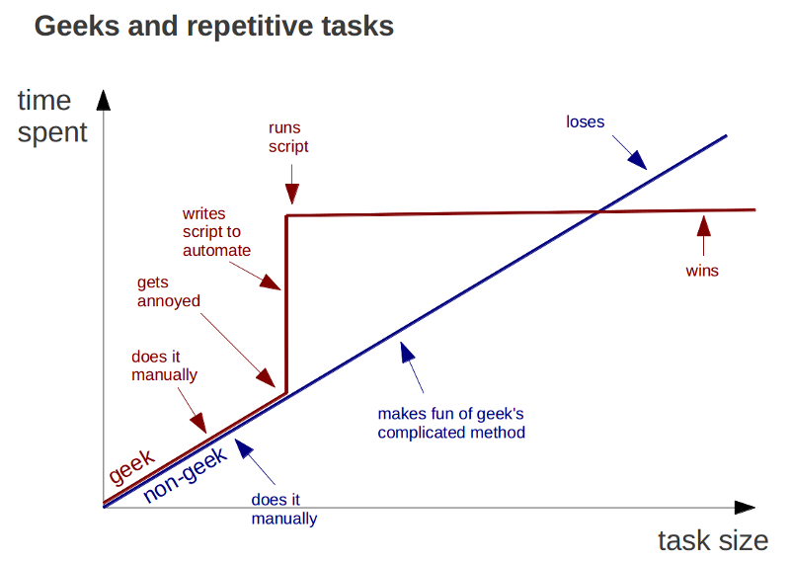
Functionalities of R (why use R or similar languages)?
For example, why use R over Excel?
Can handle large data more efficiently
Task automation and reproducible source code
Highly customizable visualization
Free and open-source
Ongoing support from a large community

Slide 5
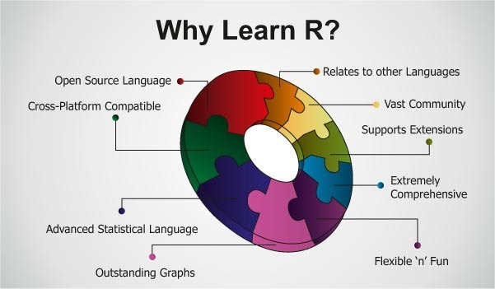
Functionalities of R (why use R or similar languages)?
Even more reasons!
Can handle many types of data (geospatial, raster, time series)
Many tools to clean & manipulate data
Advanced statistical capability (matrix arithmetic, regression, machine learning, etc.)

Slide 6
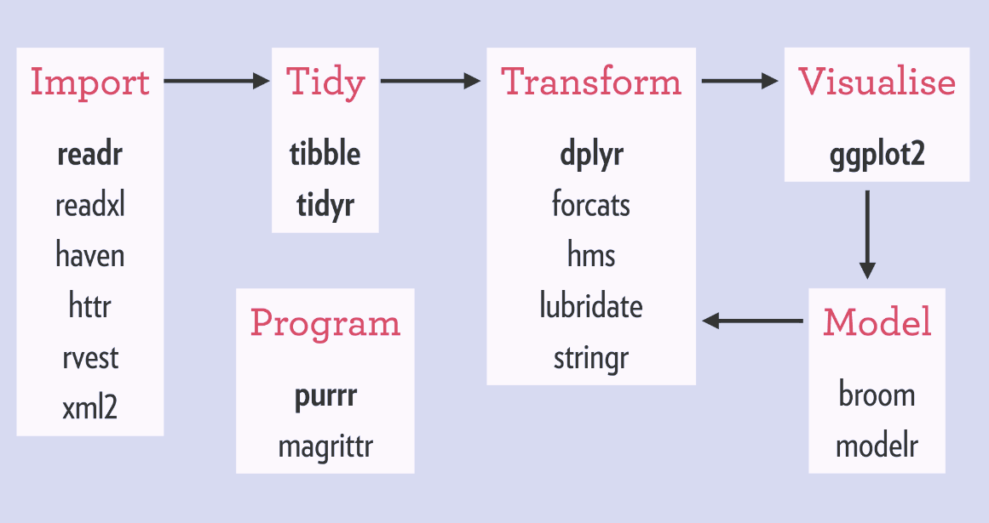
Some Staple Libraries
Libraries (or packages): user-created add-ons that increase programming capabilities. For example, libraries can allow for handling and analyzing non-standard data formats, and implementing complex algorithms
“tidyverse”
“data.table”
“here”

Slide 7
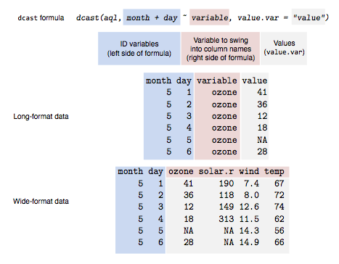
Title
text

Slide 8
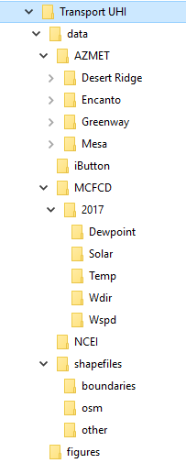
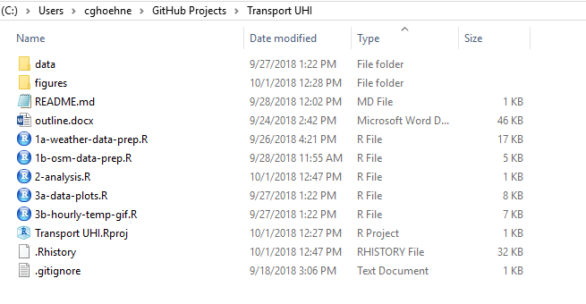
Title
text

Slide 9
Additional Resources
Setting up and using Git/GitHub with R: http://happygitwithr.com/
Intro to ‘tidyverse’ library: https://www.tidyverse.org/

Slide 10
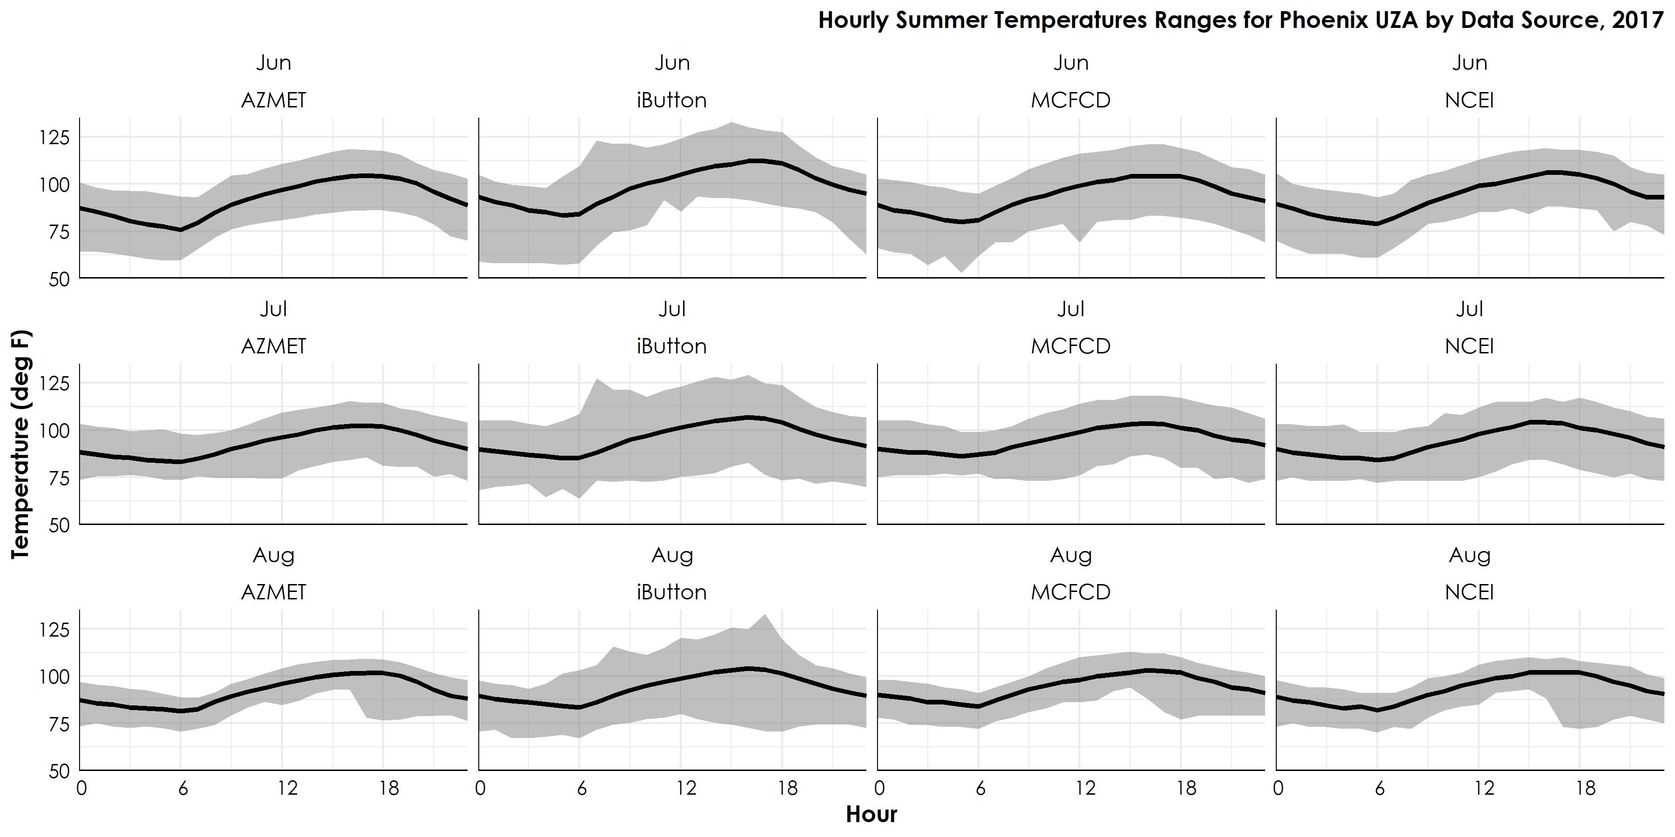
Title
text

Slide 11



Questions?
chris.hoehne@asu.edu
/in/chrishoehne
Background Photo Credit: John Samora / The Republic

